Slide 1
Introduction To Information And Communication Technology
BASIC DEFINITIONS IN ICT

Slide 2
Computer
An electronic device that processes data according to a set of stored instructions.
An electronic devices that can follow instructions to accept input, process the input and then produce information.
It is a machine that manipulates data according to a set of instructions.

Slide 3
System
A set of connected things that form a whole or work together (Oxford)
A collection of interrelated components that work together towards a collective goal.
Must have objective
Must produce an output
May have many input and outputs
May have some subsystems

Slide 4
Computers are made of
Hardware
Software

Slide 5
Hardware
Hardware: The physical parts of a computer
  Internal hardware
    Located inside the main box (system unit) of the computer
  External hardware
    Located outside the system unit and plug into ports located on the exterior of the system unit
  Hardware associated with all five computer operations

Slide 6
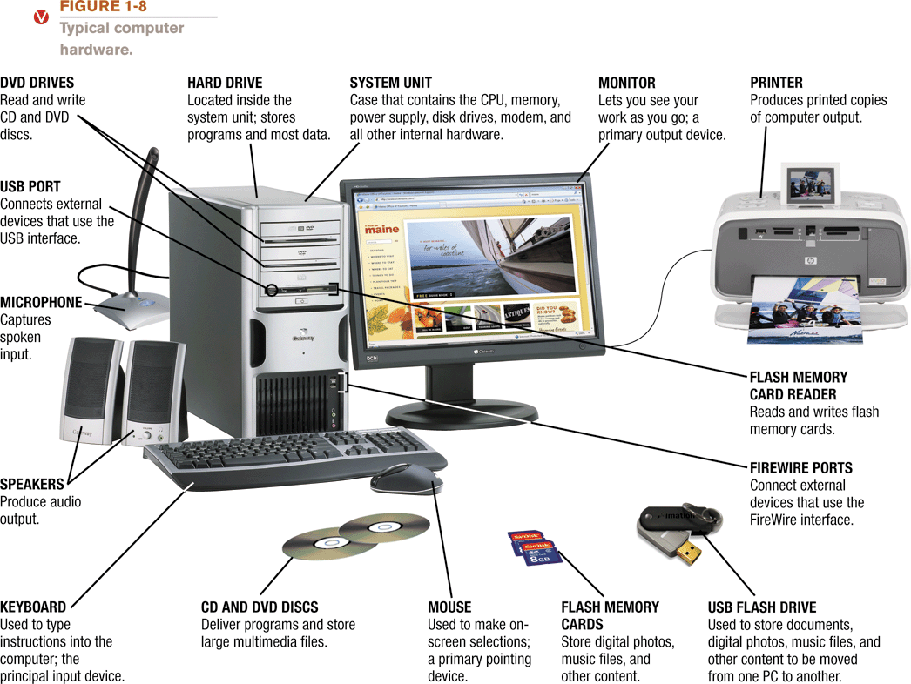

Slide 7
  Computer virus are small programs that are designed to spread from one computer to another and to interfere with computer operation.
  A virus might corrupt or delete data on your computer.
A virus program
  Infects programs, documents, databases and more …
  It is man-made
  It can hide and reproduce
  It can lay dormant (inactive) and then activate

Slide 8
Three primary sources
  The Internet
    Via downloads and exchanges
  Diskettes - now obsolete
    Exchanging disks
  Computer networks
    Can spread from one network to another

Slide 9
How do you know if you have a virus?
Lack of storage capability
Decrease in the speed of executing programs
Unexpected error messages
Halting the system
Virus Protection
The best way to cope with viruses is to recognize their existence and use an antivirus program.

Slide 10
Some tips that will help minimize your vulnerability to viruses:
Delete e-mails from unknown or suspicious, untrustworthy (unreliable) sources, especially those with files attached to an e-mail.
Never open a file attached to an e-mail unless you know what it is, even if it appears to come from a friend.
Download files from the Internet only from legitimate and reputable sources.
Update your antivirus software at least every two weeks as over 200 viruses are discovered each month.
Backup your files periodically

Slide 11
Software: The programs or instructions used to tell the computer hardware what to do
Software is a general term for the various kinds of programs used to operate computers and related devices
Software are the programs that run on a computer and perform certain functions
  System software: Operating system allows a computer to operate
    Boots the computer and launches programs at the user’s direction
    Most use a Graphical User Interface to interact with the user via windows, icons, menus, buttons, etc.
    Windows, Mac OS, Linux, etc.
  Application software: Performs specific tasks or applications
    Creating letters, budgets, etc.
    Managing inventory and customer databases
    Editing photographs
    Scheduling appointments
    Viewing Web pages
    Sending and receiving e-mail
    Recording / playing CDs
    Designing homes
    Playing games

Slide 12
Data
are raw facts or observations that have little or no value until they have been processed and transformed into information.
Examples of data: Date
Information
is data that has been processed so that they are meaningful and is useful in solving problems.
Examples of information: Bank statement

Slide 13
Network
Internet - It is the interconnection of computer networks all over the world so that users can share and exchange information.
  and communicate with each other.
A computer network is a connection of two or more computers for the purpose of communicating and sharing information and other resources.

Slide 14
Information Technology
Technology
  Application of scientific knowledge for practical purposes.
Information Technology
  Any technology concerned with the capture, storage, transmittal or presentation of information.

Slide 15
Information System (IS)
Any system that make use of IT
The role of information system is to provide information to management which will enable them to make decisions which ensure that the organisation is controlled.
IS affect:
- how manager decide
- how senior manager plan
- what produce and service are produced and how

Slide 16
Downloading —transferring data from a remote computer to one’s own computer
Cloud computing means that, instead of storing your software or data on your own PC or your own company’s computers, you store it on servers on the internet.

Slide 17
Green computing
  involves reducing the electricity consumed and environmental waste generated when using a computer.
  Strategies that support green computing include recycling, regulating manufacturing processes, extending life of computers, and immediately donating or properly disposing of replaced computers.
  When you purchase a new computer, some retailers offer to dispose of your old computer properly.

Slide 18
The Role Of Computers In ICT
  Looking up information and news
  Exchange e-mail
  Shopping and paying bills
  Downloading music and movies
  Organizing digital photographs
  Playing games
  Teleworking or Telecommuting
  Entertainment
  Tele and video conferencing
  Electronic trading
  Education – elearning
  Ecommerce – doing business selling and buying products
  GPS Tracking role
  Track your vehicles, wherever they go, using GPS.

Slide 19
Teleworking or Telecommuting
  Making use of networking technology to allow working at different locations while keeping in touch with co-workers.
Electronic Trading
  Organisations and their customers making use of networks as a means for advertising, buying and selling goods and services.
Tele and video conferencing
  Groups of people conducting meetings via a telephone or video network.

Slide 20
Computers in education
  use presentation graphics software such as PowerPoint to show their lecture outlines and other materials on classroom screens.
  Distance learning, or e-learning,
Computers in business
  Makes businesses more profitable
  ecommerce
Computers in health
  telemedicine —medical care delivered via telecommunications.
  “Teleradiology” to exchange computerized images such as X rays via telephone-linked networks
Computers are used to design products
  Assembly lines are automated

Slide 21
Money: Toward the Cashless Society
Leisure: IT in Entertainment & the Arts
downloading —transferring data from a remote computer to one’s own computer.
Ways For You To Find Employers

Slide 22
Computers at home
  Business
  Entertainment
  Communication
  Education
Computers in health care
  Revolutionized health care
  New treatments possible
  Scheduling of patients has improved
  Delivery of medicine is safer
Computers in government
  Necessary to track data for population
  Police officers
  Tax calculation and collection
  Governments were the first computer users

Slide 23
Advantages of using computers
Speed
  Computers can process millions of instructions each second in a very short time
Accuracy
  Calculations done by a computer is likely to be completely accurate.
  Human errors such as typing errors can be reduced or eliminated.
Reliability
  Computer based systems in org. Operate for 24 hrs and are ever halted for repairs or routine maintenance.
  The electronic components in modern computers are dependable and reliable because they rarely break or fail.

Slide 24
Consistency:
  Given the same input and processes, a computer will produce the same results — consistently.
Storage:
  A computer can transfer data quickly from storage to memory, process it, and then store it again for future use.
  Many computers store enormous amounts of data and make this data available for processing anytime it is needed.
Communications:
  Most computers today can communicate with other computers, often wirelessly.
  Computers with this capability can share any of the four information processing cycle operations — input, process, output, and storage — with another computer or a user.
  Can send and retrieve data from other computers if in a network
  Computers greatly speed up problem solving and other tasks, increasing users’ productivity

Slide 25
Advantages of using computers for data processing
Faster data input, processing and retrieval.
Tireless--can work 24 hours a day, 7 days a week.
Less prone to error.
Produce output requirements easily.
Can send and retrieve data from other computers if in a network.

Slide 26
Disadvantages of using computers
Health Risks:
  Prolonged or improper computer use can lead to injuries or disorders of the hands, wrists, elbows, eyes, neck, and back.
Violation of Privacy:
  Nearly every life event is stored in a computer somewhere . . . In medical records, credit reports, tax records, etc.
  In many instances, where personal and confidential records were not protected properly, individuals have found their privacy violated and identities stolen.
Public Safety:
  Adults, teens, and children around the world are using computers to share publicly their photos, videos, journals, music, and other personal information.
  Some of these unsuspecting, innocent computer users have fallen victim to crimes committed by dangerous strangers.
  Protect yourself and your dependents from these criminals by being cautious in e-mail messages and on Web sites.
  For example, do not share information that would allow others to identify or locate you and do not disclose identification numbers, passwords, or other personal security details.

Slide 27
Impact on Labor Force:
  the skills of millions of employees have been replaced by computers.
  Thus, it is crucial that workers keep their education up-to-date.
  A separate impact on the labor force is that some companies are outsourcing jobs to foreign countries instead of keeping their homeland labor force employed.
Impact on Environment:
  Computer manufacturing processes and computer waste are depleting natural resources and polluting the environment.
  When computers are discarded in landfills, they can release toxic materials and potentially dangerous levels of lead, mercury, and flame retardants.

Slide 28
Disadvantages of using computers
Require skilled manpower for design and programming and data encoding
Require electricity
Require air conditioning for non-stop work
Expensive to acquire and maintain
Require frequent upgrade due to fast developments in hardware and software
Require regular staff training

Slide 29
Limitations of computer-based processing
Judgement/experience: Despite advances in artificial intelligence techniques and expert systems,
  computer-based information systems are considered incapable of solving problems using their own judgement and experience.
Improvisation/flexibility:
  computer-based information systems are unable to react to unexpected situations and events.
  Additionally, since most systems are created to fulfill a particular function, it can be difficult to modify them to meet new or changed requirements.

Slide 30
Innovation:
  Computers lack the creativity of a human being. They are unable to think in the abstract and are therefore restricted in their ability to discover new ways of improving processes or solving problems.
Intuition:
  Human intuition can play an important part in all certain social situations. E.g. one might use intuition to gauge emotional state of a person before deciding whether or not to give them bad news. BIS cannot use intuition in this way and are therefore unsuitable for certain kinds of situations.
Qualitative information:
  Managers often make unstructured decisions based on the recommendations of others. Their confidence in the person they are dealing with often has a major influence on the decision itself. Once again, BIS cannot act upon qualitative information of this kind.

